Slide 1
Classification of Data Mining System

Slide 2
Data Mining: Confluence of Multiple Disciplines
Database
Technology
Statistics
Machine
Learning
Data Mining
Visualization
Pattern
Recognition
Other
Disciplines
Algorithm
Notes:
‹#›

Slide 3
Why Classification?
Interdisciplinary field (diff. techniques such as fuzzy, set theory, neural n/w, knowledge)
DM system integrates techniques from spatial database, pattern recognition, computer graphics, web technologies, economics, bioinformatics or psychology
Research is expected b/c of various disciplinary
Need of classification to identify and best match the user needs

Slide 4
Classification
The kinds of database mined
The kinds of knowledge mined
The kinds of techniques utilized
The kinds of applications adapted

Slide 5
Kinds of Database mined
Database are constructed with diff. models and diff. kinds of data
Classification is based of model & kind of data
Relational, transactional, object-relational, or data warehouse mining system, based on models
spatial, text, time series, multimedia or world wide web mining system , based on kind of data

Slide 6
Kinds of knowledge mined
Based on DM functionalities & levels of abstraction
Functionalities based on characterization, discrimination, association and correlation analysis, clustering and so on
Levels of abstraction based on generalized knowledge, primitive knowledge or knowledge at high level.
Also based on mine data regularities (commonly occurring patterns) versus irregularities (such as exceptions, or outliers)

Slide 7
Kinds of techniques utilized
DMS categorized based on data mining techniques
  User interaction involved
    Autonomous systems
    Interactive exploratory systems
    Query driven systems
  The methods of data analysis involved
    Database / data warehouse oriented techniques
    Machine learning, statistics, visualization
    Pattern recognition and so on

Slide 8
Applications
DMS can also be categorized a/c to the applications they adapt
Ex. DMS may be customized specifically for finance, telecommunications, DNA, stock markets, e-mail, and so on

Slide 9
Major Issues in Data Mining

Slide 10
Issues Based On
Mining methodology and user interaction
Performance
relating to the diversity of database types

Slide 11
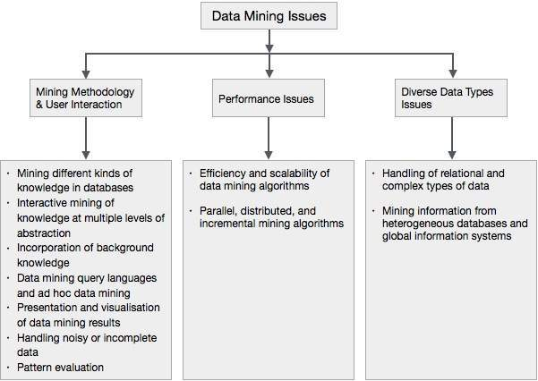
The following diagram describes the major issues.

Slide 12
Mining Methodology and User Interaction Issues
Based on the kinds of knowledge mined
how to mine knowledge at multiple granularities
Need of domain knowledge
Form of knowledge visualization

Slide 13
PERFORMANCE ISSUES
Efficiency and scalability of data mining algorithms
Parallel, distributed and incremental mining algorithm

Slide 14
Issues related - Diversity of Database Types
Handling of relational and complex types of data
Mixing information from heterogeneous databases and global information systems

